Slide 1

JAVA Training Exercises
TDD
Thomas DECOSTER
Java Senior Consultant
VPTT 2020 4.4.7.4 RC /
1

Slide 2
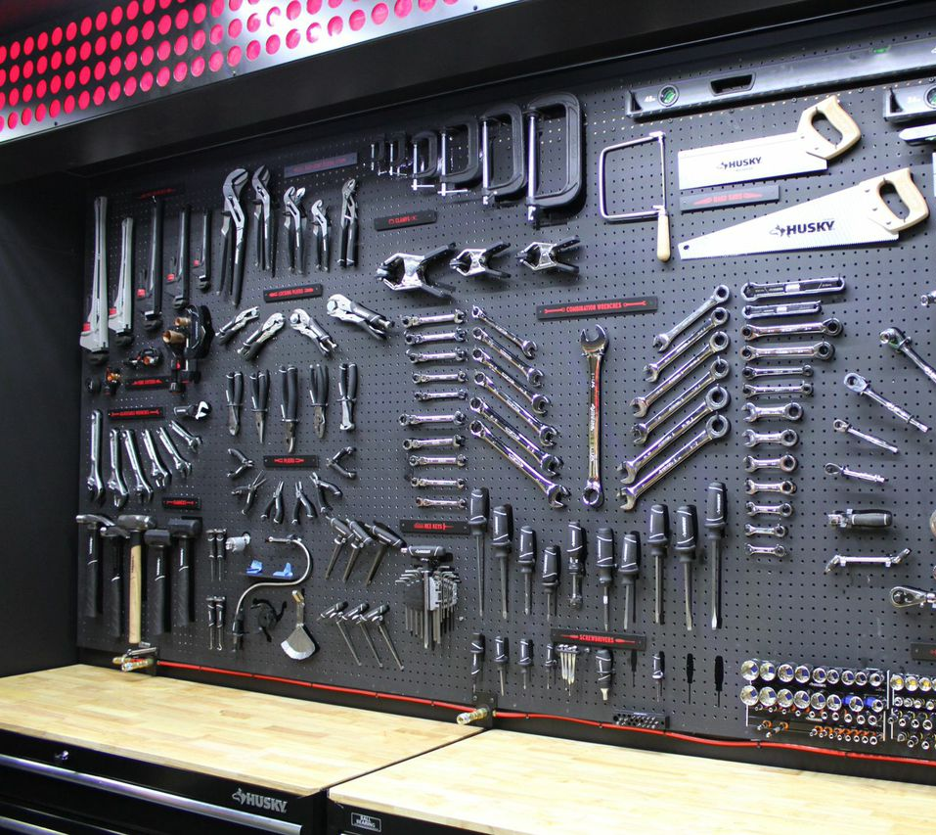
Standard Developpement
Task 1 : Cup
Implement a cup :
A cup contains 2 dices
A cup has a roll() : void method (same as die)
A cup has a getValue() : int method (same as die)
Test your Cup
Using actual dice
Then Using a dice mock
Modify Cup class to use a number of dice form 2 to 6
Update your test class
et

Slide 3
Work with legacy
Task 2 : Test Player class
Create a Unit Test for Player :
Use a Spy for Square
Modify Player to use a cup instead of 2 dices
Check your Tests are still passing
et

Slide 4
Work in TDD !
Task 3 : Player management
New User stories :
As a user, I can add a player
As a user, I can remove a player
As a user, I cannot remove a player if there is only 2 players
As a user, I cannot add a player if there are 10 players*
As a user, I can reset the player number to 2 players
Check and complete the unit test according to user stories
Check the test are all failing
Implement the user stories
Check the tests are all successful
*Hint : you will ask a question to the author of the stories, the answer is: “Violet” and “Gris”

